Slide 1
LLM Face-Off:
Open vs Closed
Nikko Carlo Yabut

Slide 2

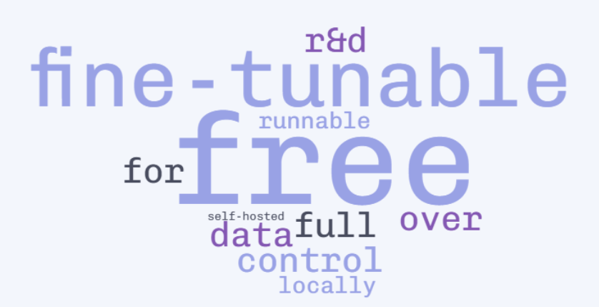







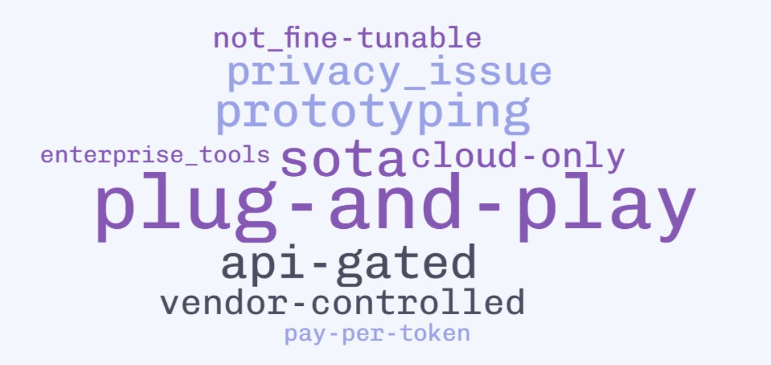







When to use what? Open-Source vs Closed-Source LLMs
LLaMA 2 (by Meta)
OpenLLAMA (by Berkeley AI)
Access Fine-Tuning Deployment Cost Performance Privacy Licensing Ecosystem Best For Ease of Use | ✅ Free to download & run locally ✅ Yes (LoRA, QLoRA, full/partial) ✅ Self-host, cloud, offline ✅ Infra-only costs ⚠️ Competitive, slightly behind top-tier ✅ Full control (local setup) ⚠️ Varies; some restrict commercial use ✅ Community-driven, open tooling 🧪 R&D, customization, education ⚠️ Needs infra setup, CLI, configs
Gemma (by Google)
Mixtral (by Mistral AI)
OPEN-SOURCE
Mistral (by Mistral AI)
Dolly (by Databricks)
Falcon (by TII)
DeepSeek (by DeepSeek AI)
LLM
GPT-4 (by OpenAI)
Claude 4 (by Anthropic)
Access Fine-Tuning Deployment Cost Performance Privacy Licensing Ecosystem Best For Ease of Use | 🔒 API-only, gated by provider ❌ No (prompt-tuning only) 🔒 Cloud-only 💰 Pay-per-use ✅ SOTA (e.g., GPT-4, Claude Opus) ⚠️ Vendor-controlled ❌ Bound by strict TOS ⚠️ Limited to official SDKs 🚀 Prototyping, enterprise, fast scaling ✅ Plug-and-play API, great docs
Gemini (by Google DeepMind)
CLOSED-SOURCE
Command R+ (by Cohere)
Ernie Bot (by Baidu)
Qwen (by Alibaba)
SenseChat (by SenseTime)
Grok (by xAI)

Slide 3

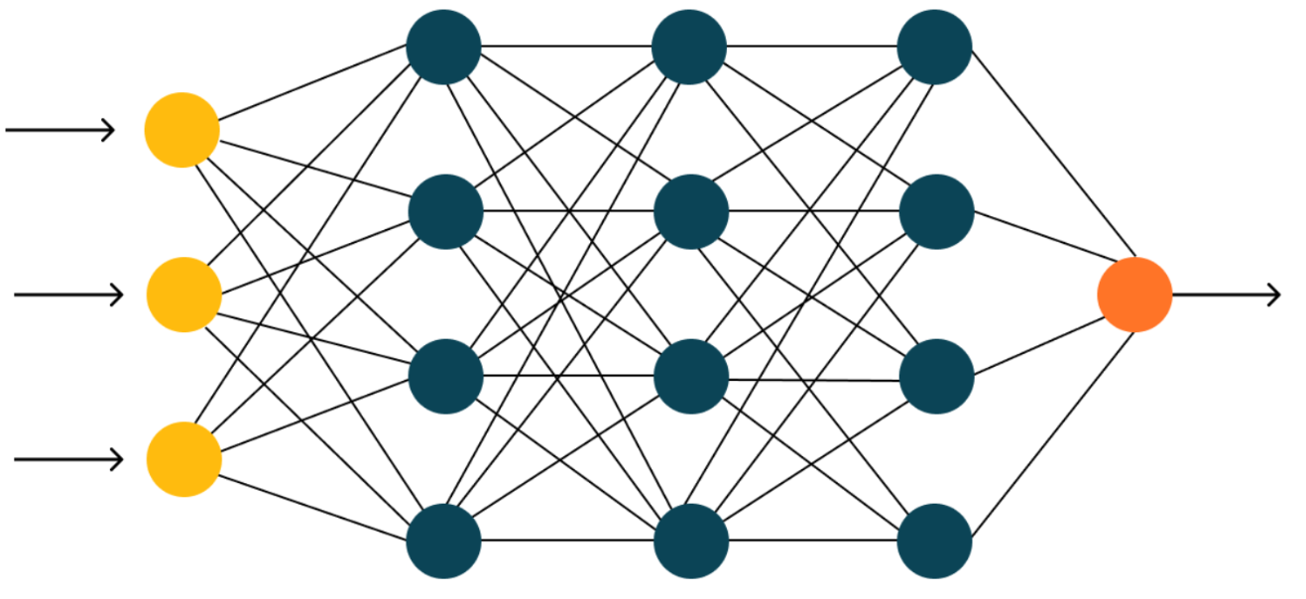

Things to be considered in deployment…
LLaMA 2 (by Meta)
🔥 Model
User: “what haffen vella?”
OpenLLAMA (by Berkeley AI)
Prompt
Gemma (by Google)
Mixtral (by Mistral AI)
Deployment: ✅ Cloud, Local /offline
Cost: ✅ Infra-only costs
Licensing: ⚠️ Varies; some restrict
commercial use
Ease of use: ⚠️ Needs infra setup
— or —
OPEN-SOURCE
Output
Mistral (by Mistral AI)
Dolly (by Databricks)
ChatGPT: The phrase "What hafen Vella?" is a viral meme that originated from a 2013 episode of It's Showtime
Falcon (by TII)
DeepSeek (by DeepSeek AI)
LLM
GPT-4 (by OpenAI)
❄️ Model
User: “what haffen vella?”
Claude 4 (by Anthropic)
Prompt
Gemini (by Google DeepMind)
Deployment: 🔒 Cloud-only
Cost: 💰 Pay-per-use
Licensing: ❌ Bound by strict TOS
Ease of Use: ✅ Plug-and-play API
CLOSED-SOURCE
Command R+ (by Cohere)
Output
Ernie Bot (by Baidu)
Qwen (by Alibaba)
ChatGPT: The phrase "What hafen Vella?" is a viral meme that originated from a 2013 episode of It's Showtime
SenseChat (by SenseTime)
Grok (by xAI)

Slide 4

You’ve got a powerful model.
Now what?

Slide 5
Train It, Prompt It, Own It:
Making LLMs Work For You
Nikko Carlo Yabut

Slide 6

Task Adaptation
LLaMA 2 (by Meta)
🔥 Model
Allows alteration of model's weights, behavior, or training data.
Full Training
Partial Training (QLoRA)
RLHF (Reinforcement Learning with Human Feedback)
User: “what hafen vella?”
Prompt
Prompting Techniques
Zero-shot Prompting
One-shot Prompting
Few-shot Prompting
…
Prompt Frameworks
RICCE
PACE
APE
OpenLLAMA (by Berkeley AI)
Gemma (by Google)
Mixtral (by Mistral AI)
Output
OPEN-SOURCE
Mistral (by Mistral AI)
ChatGPT: The phrase "What hafen Vella?" is a viral meme that originated from a 2013 episode of It's Showtime…
Dolly (by Databricks)
Falcon (by TII)
DeepSeek (by DeepSeek AI)
LLM
❄️ Model
Weights, behavior, or training
CANNOT be altered.
a.k.a. “Black Boxes”
GPT-4 (by OpenAI)
Prompt
Prompting Techniques / Frameworks
*same as above
Claude 3 (by Anthropic)
Gemini (by Google DeepMind)
Output
CLOSED-SOURCE
Command R+ (by Cohere)
Ernie Bot / Ernie 4.0 (by Baidu)
Qwen (by Alibaba)
SenseChat (by SenseTime)
Grok (by xAI)

Slide 7
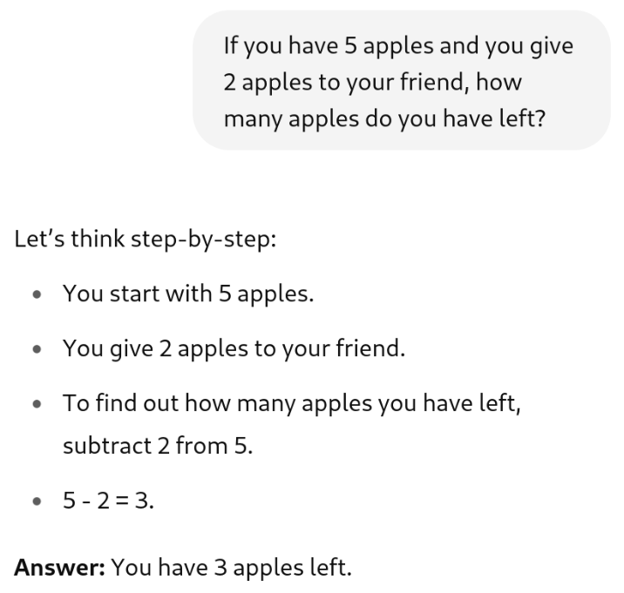
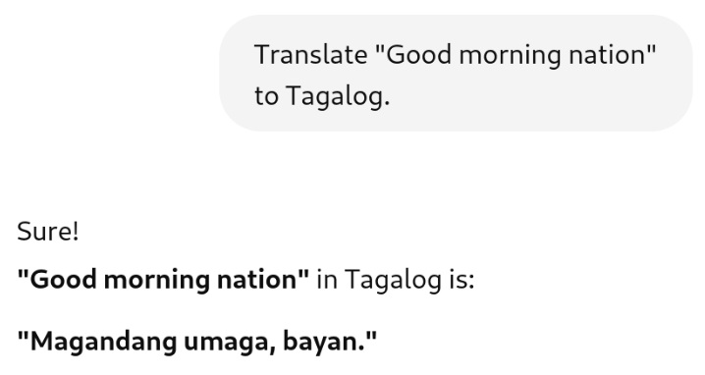
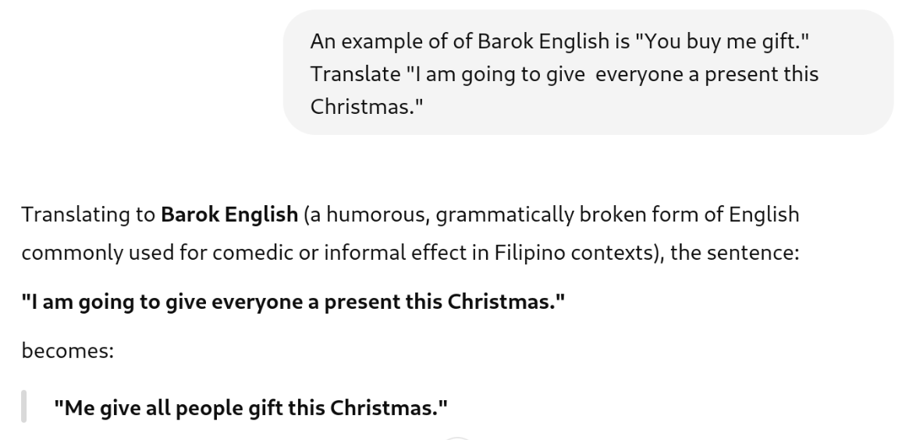
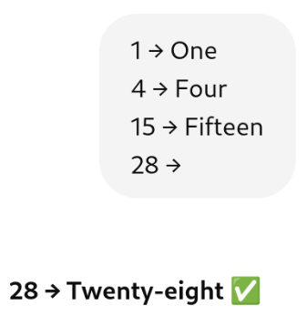
Task Adaptation (via Prompting Techniques)
ZERO-SHOT
Ask the model to complete a task with no prior examples.
🧠 Prompt:
Translate "Good morning nation" to Tagalog.
✅ Output:
"Magandang umaga, bayan."
ONE-SHOT
Provide one example to guide the model’s behavior.
🧠 Prompt:
An example of of Barok English is "You buy me gift."
Translate "I am going to give everyone a present this Christmas."
✅ Output:
"Me give all people gift this Christmas."
FEW-SHOT
Give multiple examples (2–5) to establish a pattern.
🧠 Prompt:
1 → One 4 → Four 15 → Fifteen 28 →
✅ Output:
28 → Twenty-eight ✅
Chain-of-Thought
Ask the model to think step-by-step, encouraging reasoning before answering.
🧠 Prompt:
If you have 5 apples and you give 2 apples to your friend, how many apples do you have left?
✅ Output:
You start with 5 apples.
You give 2 apples to your friend.
To find out how many apples you have left, subtract 2 from 5. 5 - 2 = 3.
Answer: You have 3 apples left.

Slide 8
Task Adaptation (via Prompting Frameworks)
RICCE
Relevance, Instruction, Clarity, Context, Examples
Example:
Relevance:
Focus on summarizing environmental issues.
Instruction:
Summarize the paragraph in 2 sentences.
Clarity: Use simple and clear language suitable for a high school student.
Context: The paragraph talks about the causes and effects of deforestation.
Examples: Example summary: "Deforestation happens when trees are cut down. It causes loss of habitat for animals and increases carbon dioxide."
🧠 Prompt:
Summarize the following paragraph in 2 sentences using simple language suitable for a high school student. The paragraph talks about the causes and effects of deforestation.
Example: "Deforestation happens when trees are cut down. It causes loss of habitat for animals and increases carbon dioxide."
PACE
Prompt, Action, Context, Evaluation
Example:
Prompt:
Translate the sentence from English to Tagalog.
Action:
Perform the translation accurately, preserving meaning and tone.
Context:
The sentence is a friendly greeting used in everyday conversation:
"Good morning, how are you today?"
Evaluation:
The output will be evaluated on correctness, naturalness, and cultural appropriateness.
🧠 Prompt:
Translate the following sentence from English to Tagalog. Make sure the translation is accurate and sounds natural in everyday conversation.
Sentence: "Good morning, how are you today?"
PEEL
Point, Evidence, Explain, Link
Example:
Point:
Regular exercise improves mental health.
Evidence:
Studies show that exercise releases endorphins, which help reduce stress.
Explain:
These endorphins act as natural mood boosters, making you feel happier and less anxious.
Link:
Therefore, incorporating exercise into your routine can significantly enhance your overall well-being.
🧠 Prompt:
Write a paragraph to explain why regular exercise is important.
Start with a clear Point.
Provide Evidence (a fact or study).
Explain how the evidence supports the point.
Link back to the importance of exercise overall.
APE
Action, Purpose, Execution
Example:
Action:
Analyze customer feedback data from our latest product launch.
Purpose:
To identify key strengths and areas for improvement.
Execution:
Provide a summary report highlighting common themes and actionable insights.
🧠 Prompt:
Analyze the customer feedback from our recent product launch.
Your goal is to identify the main strengths and weaknesses mentioned by customers.
Provide a concise summary report that highlights the most common themes and suggests actionable improvements.

Slide 9
ACTIVITY 1: Before and After Prompting
In this activity, you will complete the same task twice—first using a basic prompt, then using an improved prompt by using prompting techniques and prompting framework (RICCE, PACE, PEEL, or APE).
Do the task using a Zero-Short Prompt without any specifics.
Repeat the task using the “Better Prompt.”
Compare your two outputs and share your work

Slide 10
ACTIVITY 1: Before and After Prompting
Is there a bad prompt? Explain.

Slide 11
ACTIVITY 1: Before and After Prompting
Is there a bad prompt? Explain.
There are no bad prompts — only unrefined ones.
No prompt is bad if it's part of a learning or refinement process.
Prompts evolve; vague ones spark curiosity and learning.
Even a “bad” prompt is a step toward a better one.

Slide 12
ACTIVITY 1: Before and After Prompting
Is there a bad practice in prompting? Explain.

Slide 13

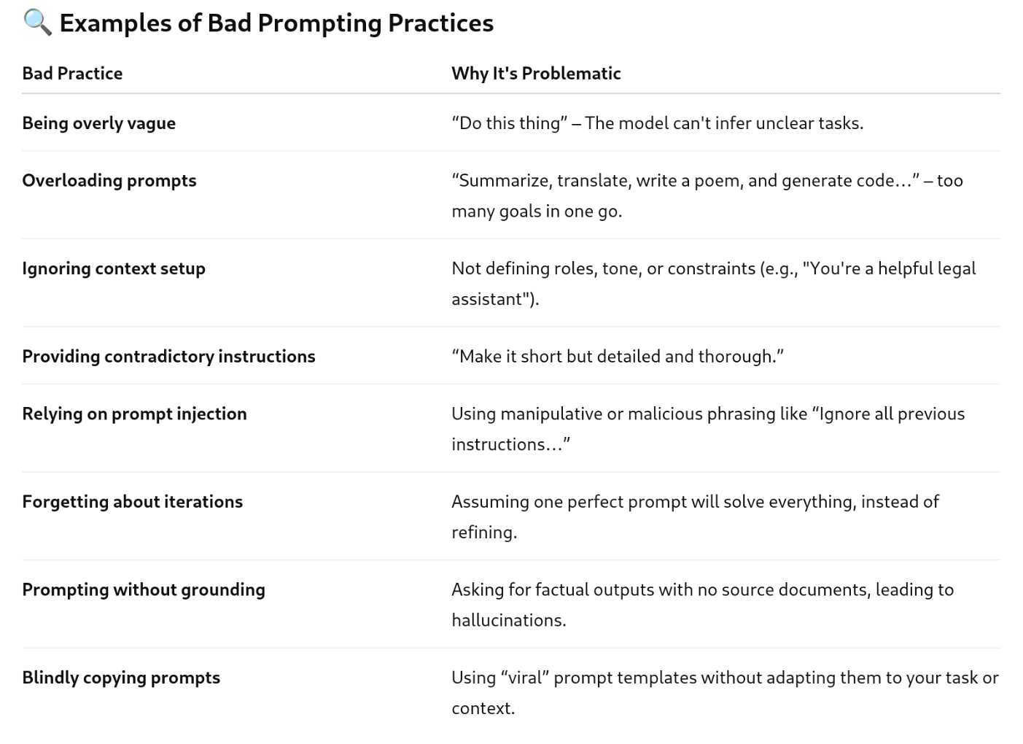

ACTIVITY 1: Before and After Prompting
Is there a bad practice in prompting? Explain.
Prompting in the Real World = Prompting Under Constraints
In theory, every prompt is a valid starting point. But in production or limited-resource environments (like APIs, embedded systems, or commercial apps), prompting has economic and computational stakes.
Bloated prompts → Wastes tokens → increases cost and latency
Unbounded outputs (e.g., "Write as much as you can")
→ Can trigger runaway generation → hallucination → wastes tokens
Too many iterations → More back-and-forth → slower workflows
📉 Real-World Impact of Poor Prompting in Production
💸 Higher API costs (OpenAI, charge per token)
🕒 Increased latency → worse UX
🧪 Unstable output → more QA/testing time
💥 Scaling issues → can’t afford to run models at scale with inefficient prompts

